Slide 1
State Cuts to Education
There is a real crisis in the funding of public education in the State of California

Slide 2
Vote on Prop 30
Since 2008, Statewide
Enrollment has dropped by 485,000 students
Class offerings have been cut by 24%
Funding has been reduced by $809 million
WITHOUT PROP 30
The Community Colleges could see an additional $338 Million slashed from their budgets
Notes:
Figures taken from the L.A. Times Sept. 28, 2012, “Brice W. Harris to head state's community colleges”

Slide 3
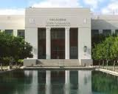
Pasadena City College’s Response to the Cuts
Course offerings reduced (14% since 2010-11).* Faculty & Staff encouraged to retire (2011).
Many Adjuncts not rehired and Retirees scheduled to teach as adjuncts summarily fired (four days before the Spring 2012 semester).
Facilities and teaching divisions remain understaffed.
End of the year Budget Surpluses used to offset gap in State funding.
Winter cut and a New Calendar imposed.
Notes:
>In 2010-11, Rocha's first year, PCC offered 5,523 sections. This year, 2012-13, PCC will offer 4,777 sections; this represents 746 less sections @ 14% cut.
>Some retirees were given as little as 2 days notice that classes that had prepare for would be taught by someone else.
>From the district’s own budget reports, PCC 2011-12 fiscal year ended with a $7.2 million surplus ($5.4 million of that owed to PCC by the State of California, as a deferred payment) SEE SLIDE 5 .

Slide 4
Does PCC Have A Budget Crisis? From Board Report 8/15/12 PCC’S Financial Status Report filed with the Chancellor’s Office
Notes:
NO, there is no Budgetary crisis. PCC’s official report to the Chancellor’s Office says the the college DOES NOT “have significant fiscal problems that must be addressed”
Indeed, PCC has a minimum of $18 million surplus.

Slide 5
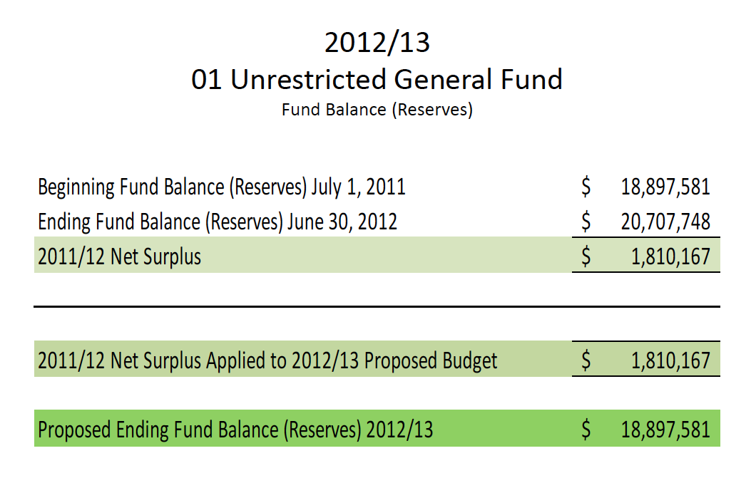
PCC Still has a healthy reserve fund. A cash flow problem (State reimbursements) is not a budget problem. (V.P. Miller: Board Report 9/05/12)
Notes:
>The $1,810,167. represents the district’s budget surplus NOT INCLUDING the State’s deferred payment of $5.4 million still pending. Taking into account the state’s deferred payment 2011-12 ended with a 7.2 million.
>State requires a 3% to 5% be held in reserve. PCC has 17%+ in reserve

Slide 6
Classes Cut Despite Demand & A Budget Surplus* Numbers of Class Sections offered: taken from PCC Courier 9/20/12.
Notes:
>SECTION Numbers (i.e. number of classes) offered in Winter & Summer, taken from PCC Courier 9/20/12
>Approximately 8,000 students took the 271 sections offered last Winter (Brd. Meeting 8/29/12).

Slide 7
Cutting Winter Intercession Saves Only 0.05% of PCC’s Budget (from Board Report 8/29/12)
8,000 students attended the 271 class sections offered last Spring.
Notes:
Is this amount worth disrupting the Student progress and program planning and confusing our transfer institutions?
Again, the $2.1 million deficit reflected here does not take in to account the State reimbursement to PCC of $5.4 million.

Slide 8
How is PCC Spending Its Money?
8 new administrative positions*
New position of General Counsel $179,000
New Building Projects (U-Building, $8.5 million so far )*
President’s Salary increases $ 5,000 this year (total salary now $248,000) & $7,500 in 2013
Lawsuits resulting from renegade administrators
Paying for the “effects” of an unplanned calendar change
Notes:
>There are actually far more than 8 positions but these represent whole new positions. The new positions include: , Supervisor, HR (Management), Executive Director of HR (no longer one VP now two positions); Internal Auditor/Compliance Officer (Exc.-Proposed), Controller Director of Fiscal Services (proposed), Executive Director of Business Services (no longer VP now three positions) ; Dean of Library & Online learning, Assis. Dean of Library (2 positions instead of one); Dean of Faculty; Dean of Workforce Education; Assoc. Dean, Educational & Program Review; Assoc. Dean, Teaching & Learning Center.
>Some new administrative hires have occurred without approved hiring committees, for example, (ironically) the Director of HR. The hiring committee members were not approved until after she was offered the position.
>The Academic Senate in 2010-11 formally protested the creation of the new General Counsel position.
$8.5 million just to evacuate the U-building and create the “Science Village” in portable classrooms. The C, E, & R buildings were given the same risk category rating (V) as the U building; the C-SA & W buildings were given an even higher risk rating of VI.
Reported 10/6/12 in Pasadena Star News: “The highest paid local college president is Mark Rocha of Pasadena City College. He was hired in July 2011 at a salary of $230,000. An automatic raise this year brought his salary to $235,000. According to Rocha's contract, his salary will continue to increase each year, reaching $265,000 in 2015.” Read more: http://www.pasadenastarnews.com/news/ci_21714374/local-community-college-presidents-earn-hundreds-thousands-salary?IADID=Search-www.pasadenastarnews.com-www.pasadenastarnews.com#ixzz28ldoUZLV

Slide 9
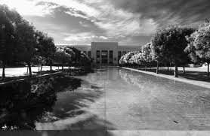
While many Community Colleges that do not have deep reserves have had to cancel their Winter intersession,
NO OTHER COMMUNITY COLLEGE EXCEPT PCC HAS CHANGED ITS CALENDAR MID-YEAR.
Notes:
On 8/29/12, The Board of Trustees took the incautious step of changing the “current approved” college calendar after its publication and after academic planning had taken place base on the published calendar.
>Academic Senate Pres., Dustin Hanvey, asked the BoT (8/29) to put off the vote until Oct. 1 to let faculty discuss the pedagogical issues involved in the change to the proposed “Trimester.” these issues would include the Unit value of courses in the new configuration and how our Educational partners (UC & CSU) would interpret them (semesters & quarters units differ).
Before the vote by the Trustees to eliminate Winter, Pres. Rocha reminded the Trustees of what he had told them in a meeting 2 months prior; the Board had “the absolute authority” to take money from the reserves to fund Winter, and the Board’s “clear guidance” to him was not to take money from the reserves. Students, Faculty & Staff have unanimously called for the reinstatement of Winter &, in the first week of circulation, over 2,000 students have signed a petition requesting the reinstatement of Winter.

Slide 10
New Calendar & No Winter
Current Calendar
2012-2013
Fall: Aug 27—Dec 16
Winter: Jan 7-Feb 14
Spring: Feb 19—Jun 19
Summer: Jun 24—Aug 24
Imposed* “Tentative” Calendar
2012-13
Fall: Aug 27—Dec 16
Spring: Jan 7—May 5
Summer: May 13—Aug2
*On PCC Website
Confused?
Notes:
>Trustees Wah, Brown & Thomson voted to postpone the vote until faculty could examine the issue. Trustees Baum, Mann, Fellow and Martin forced a vote. Only Trustee Brown voted against the calendar change, and Wah abstained.
>Thomson voted for the “Tentative” Calendar on the assurances of Dr. Bell and Dean Olivo that students who were ready to transfer would be able to take their necessary courses. Dr. Bell said “if we are able to identify these students, we will be able to serve their needs” (as recorded on Audio of BoT meeting 8/29/12). The problem is our IT system does not do a good job of identifying these student. The Board should know this as the purchase of a new computer operating system is also one of the things on which PCC is spending its money.

Slide 11
Benefits of Current Calendar
Our current calendar allows students to complete 3 class terms: Fall, Winter and Spring that can be applied toward completion of their educational goals or Fall admission to the UC and CSU campuses.
While the imposed "tentative" calendar only allows students to complete 2 class terms: Fall and Spring.
Notes:
UC & CSU does not take courses completed in Summer under consideration for fall admissions.

Slide 12
Calendar Confusion
Spring begins on January 7 in the New Calendar, not approved through Shared Governance.
PCC’s website promises “all students will have classes in the winter starting January 7,” but these are NOT Winter classes.
Student Success Taskforce: The longer it takes students to get through their course work the less likely they are to complete their educational goals.
Notes:
Confusion caused by the new calendar is only increased by information provided to the students in print and on the website (see quote in slide). From website: “The newly approved calendar insures that all students will have classes in the winter starting January 7.” The New Calendar has not been approved and “classes in winter” are Spring semester classes.

Slide 13
Open Democratic Process?
AB 1725 assures that all parts of the campus community take part in the large decisions that affect campus life.
Calendar Decisions REQUIRE the Consultation & Agreement of The Campus Community; that is how it’s supposed to work.
Notes:
Shared Governance Committees are made up of Administration, Management, Faculty, Staff and Students who help to decided, Curriculum, Budget, Calendar, Program development & so on. Agreement must occur in the 10+1 categories outlined in the law, AB 1725, the calendar falls with in these categories.

Slide 14
A Breakdown of Shared Governance
AB 1725 Specifies:
NO agreement has been reached, & there is NO fiscal reason to sidestep the democratic process.
Notes:
>In summer (when most faculty & many students are away) the President & the BoTs unilaterally changed the Calendar without consulting the campus or vetting the decision through the shared governance process.
>The BoTs approved this New Calendar on 8/29/12 despite the protest of the Academic Senate, the Associated Student Gov., Staff & community, members some of whom were NOT able to get into the locked Public meeting.

Slide 15
Disregard of the Democratic Process
“The imposition of this proposed ‘tentative student calendar’ constitutes a violation and blatant disregard of shared governance and all the hard work [the Calendar Committee] put in over the past year to develop our current calendar which includes Winter Intersession.” (Dr. Walter, Co-Chair of the Calendar Committee)
The Current Calendar (approved by the Academic Senate in April 30, 2012) as published in the catalog is an implied contract between the district and the students.
Notes:
The current calendar that included Winter had been fully vetted through Shared Governance for 2012-13. The Board of Trustees voted and approved the current Calendar in April 2012 & it was filed with the Chancellor’s Office.

Slide 16
The New Calendar Breaks Faith With The Students and The Community
Student Petition
Notes:
This is the petition students began circulating the first week of October (2012,) and they have collected over 2,000 signatures just within that first week (presented at 10/3/12 BoT meeting).
>CSU & UC will not take into consideration for transfer approval courses completed in the summer session. The Board members admitted not considering the adverse effects the imposition of the new calendar would have on transfer plans, educational plans (required of the students when they register), student work, medical, daycare and travel plans made months in advance.
>As early as July, Assoc. Students PCC (Student Body Government—7/25/2012, Resolution #0012, “On the Proposal of the Trimester”) published a resolution opposing the new “Trimester” stating: Eliminating Winter would disrupt and “cause maximum upheaval to a student’s completion timeline.” It also reiterated the students’ “near universal support” for Winter intersession in every opinion poll (including comments during every public and town hall event) over the last few years.

Slide 17
From Bad
Divisions reorganized, without shared governance.
Classes cut by 14% & Winter cut without shared governance.
Calendar reconfigured mid-year (confusing students & our transfer institutions—CSU & UC) without shared governance.
To Worse
Community locked out of “open” Board Meetings during the calendar discussion.
Academic Planning in Confusion.
Hiring committees formed without shared governance.
U-Building vacated before a public vote for bond monies is made.
Notes:
>2010-11 Rocha's first year we had 5,523 sections. This year 2012-13 we will have 4,777 so that is 746 less sections @ 14% cut.
>Our transfer institutions are concerned about the unit value of courses completed in a “Trimester”, a term Rocha invented.
>Some new administrative hires have occurred without approved hiring committees, for example, (ironically) the Director of HR. The hiring committee members were not approved until after she was offered the position.

Slide 18
Who Serves Who?
The Board members, elected by the citizens in PCC’s 7 districts, should represent the interests of the community & work with Shared Governance on campus.
If Board members are not listening to the students or the campus community, in whose interest are they voting?
Notes:
Students are members of the voting community too.

Slide 19
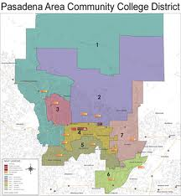
Who Represents Your District?
Geoffrey L. Baum—Area 1; Dr. Jeanette Mann—Area 2;
Berlinda Brown— Area 3; William E. Thomson—Area 4; Linda Wah—Area 5; John Martin—Area 6; Dr. Anthony R. Fellow—Area 7
Notes:
NOTE: Copy for handout or reference when audience sees last slide

Slide 20
Voting Yes for Prop 30
can improve access to Higher Education in the State of California
Notes:
Prop 30 will NOT fund private schools but insofar as it funds Cal. Community College it will allow for ACESS to the private university.

Slide 21
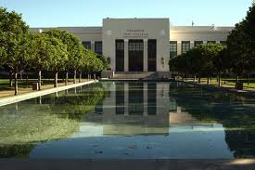
Contacting The Trustees of
Can improve access to Higher Education & preserve the Democratic Process locally at PCC.

Slide 22
Pasadena City College ~Needs You~
Get involved!
Email the Board of Trustees.
Ask them to:
Retract their Calendar vote
Reinstate Winter intersession
Respect the process of Shared Governance (AB 1725)
Notes:
Again the law states that the District must come to mutual agreement in the 10+1 categories outlined in AB 1725; the calendar falls within these categories.
>or abiding by the democratic process.

Slide 23
Write this down
Pres. Geoffrey L. Baum: President, Area 1, glbaum@pasadena.edu
Dr. Jeanette Mann: Area 2, jxmann@pasadena.edu
Berlinda Brown: Area 3, bxbrown@pasadena.edu
William E. Thomson: Area 4, wethomson@pasadena.edu
Linda Wah: Area 5, lswah@pasadena.edu
V.P. John Martin: V.P., Area 6 jhmartin@pasadena.edu
Dr. Anthony R. Fellow: Area 7, artfellow@pasadena.edu

